Slide 1


What your client’s business is Worth
…and why it matters
Rory Sheppard / ActionCOACH of West Texas
600 S. Tyler, Suite 2100 Amarillo, TX 79101 rorysheppard@actioncoach.com • 806 699-1024 • WestTexas.ActionCOACH.com

Slide 2
Only 2% of small business owners know their business valuation
98%
Don’t Know

Slide 3
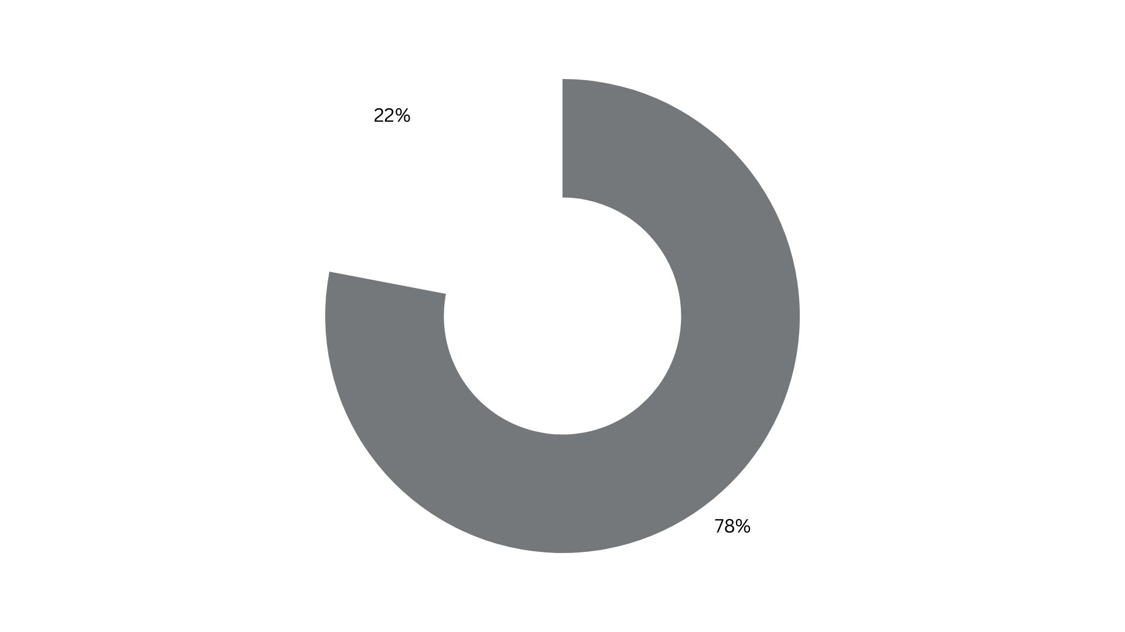
… expect 60-100% of retirement to be funded by sale of their business
YET, 78% ...

Slide 4
The Roadblocks
Expensive
Traditionally, can cost > $10k
Time Consuming
Traditionally, can take > 4 weeks
Complicated
Intensive process for already busy owners
Not Now
Owners wait until an event

Slide 5








BUSINESS VALUATION
Reasons Business Owners Typically Need A Business Valuation
SELLING YOUR BUSINESS
PLANNING FOR RETIREMENT
PROPER PROTECTION
FUNDING YOUR BUSINESS
ESTATE OR TRUST PLANNING
GRANTS OR GIFTING
SUCESSION PLANNING
LOOKING TO BUY A BUSINESS

Slide 6

When is the right time to know?
HOW TO GROW
HOW TO RESTRUCTURE
WHEN TO SELL
Any time.

Slide 7
Get the Big Picture
Worth
Deeper understanding of your largest asset
Protection
Ensure you have the right amounts of insurance
Plan Your Future
Know the facts for a more accurate retirement or estate plan
Make Better Decisions
Guided by facts
Know Your Potential
Understand the ways you can increase the value of your business

Slide 8

A business valuation can put you ahead

Slide 9
The Complexity Stays Where it Should
… Behind the Scenes

Slide 10
The details you need
Asset Sale Value
$13,656,414
Equity Value
$14,769,809
Enterprise Value
$14,759,552
Liquidation Value
$535,619
This common transaction-oriented fair market value conclusion includes the firm’s inventory, furniture, fixtures and equipment, and all intangible assets ranging from customer base to goodwill.
This fair market value conclusion is the value of the company available to its owners or shareholders and incorporates all of the assets included in the “asset value” plus the firm’s liquid financial assets (cash, A/R, deposits, etc.) and minus it’s liabilities (ST and LT).
This fair market value estimate is equal to the “total value of the firm” or the value of the firm’s equity plus its long-term debt, e.g. it reflects the value of the entire capital structure (equity and debt holders) or “enterprise.”
The liquidation value conclusion is based on the key assumption of insolvency and the immediate sale of all assets (on or off the balance sheet) at or near “fire sale” level coupled with the nearly simultaneous retirement of all liabilities. This figure does not include accounts receivable.

Slide 11

Let us generate a business valuation to give your client the facts they need to make sound financial decisions.

Slide 12
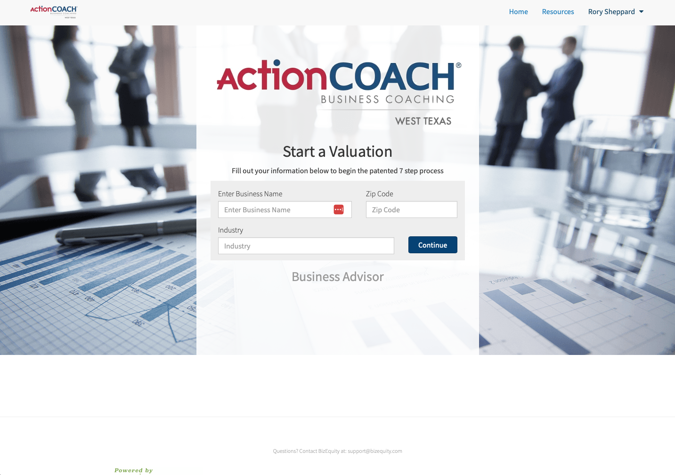

Slide 13
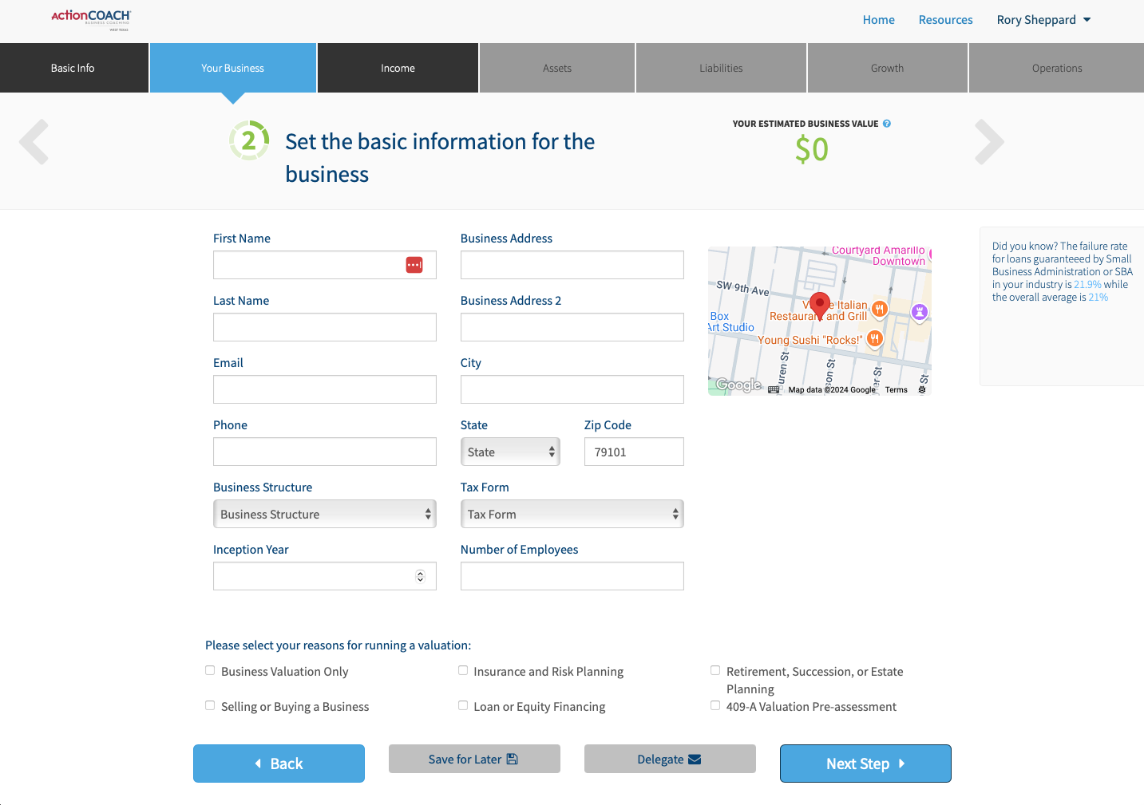
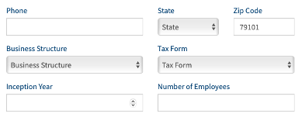

Slide 14
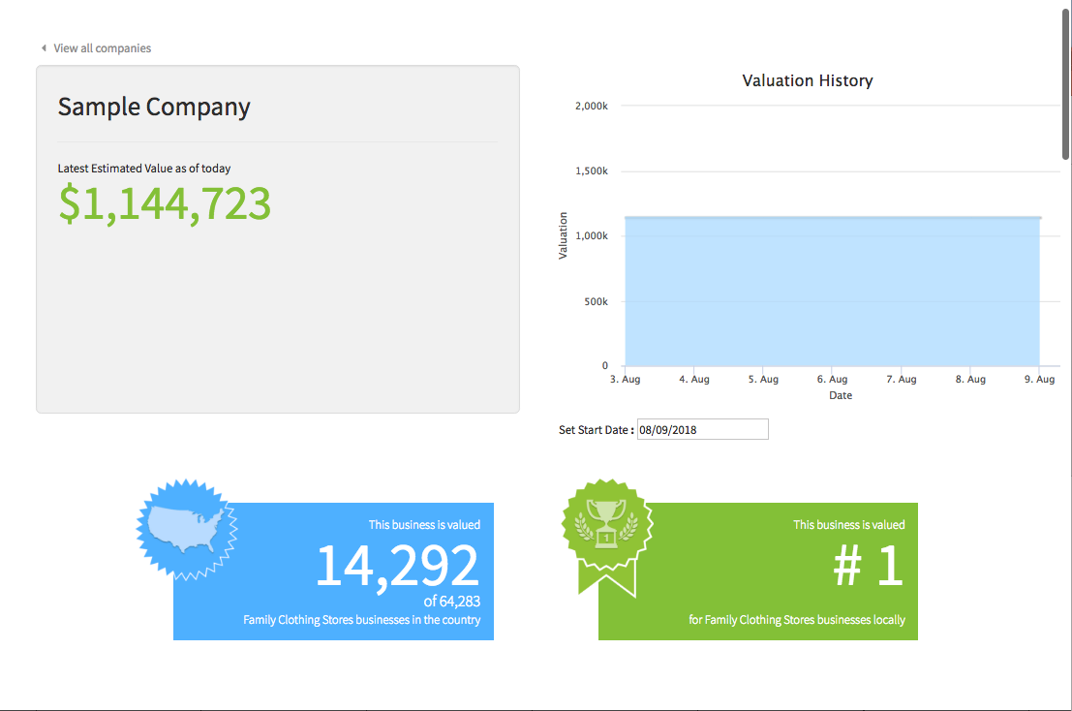

Slide 15
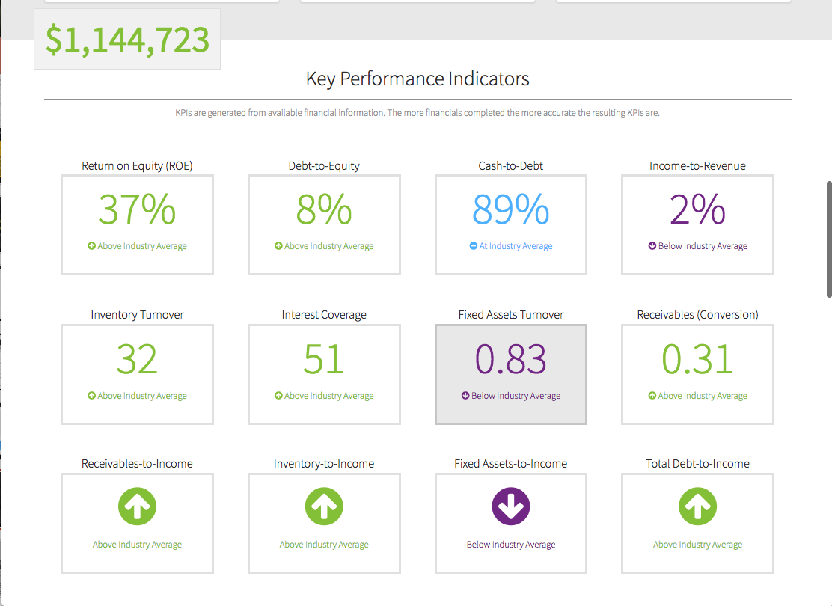

Slide 16
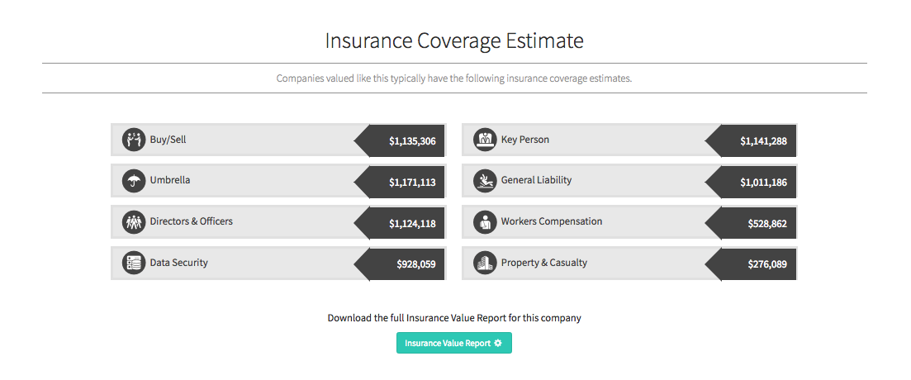

Slide 17
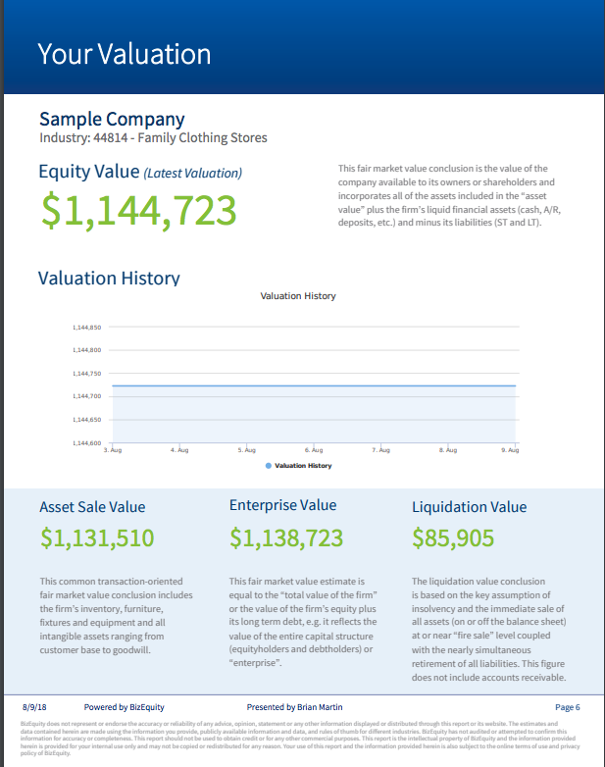



Slide 18
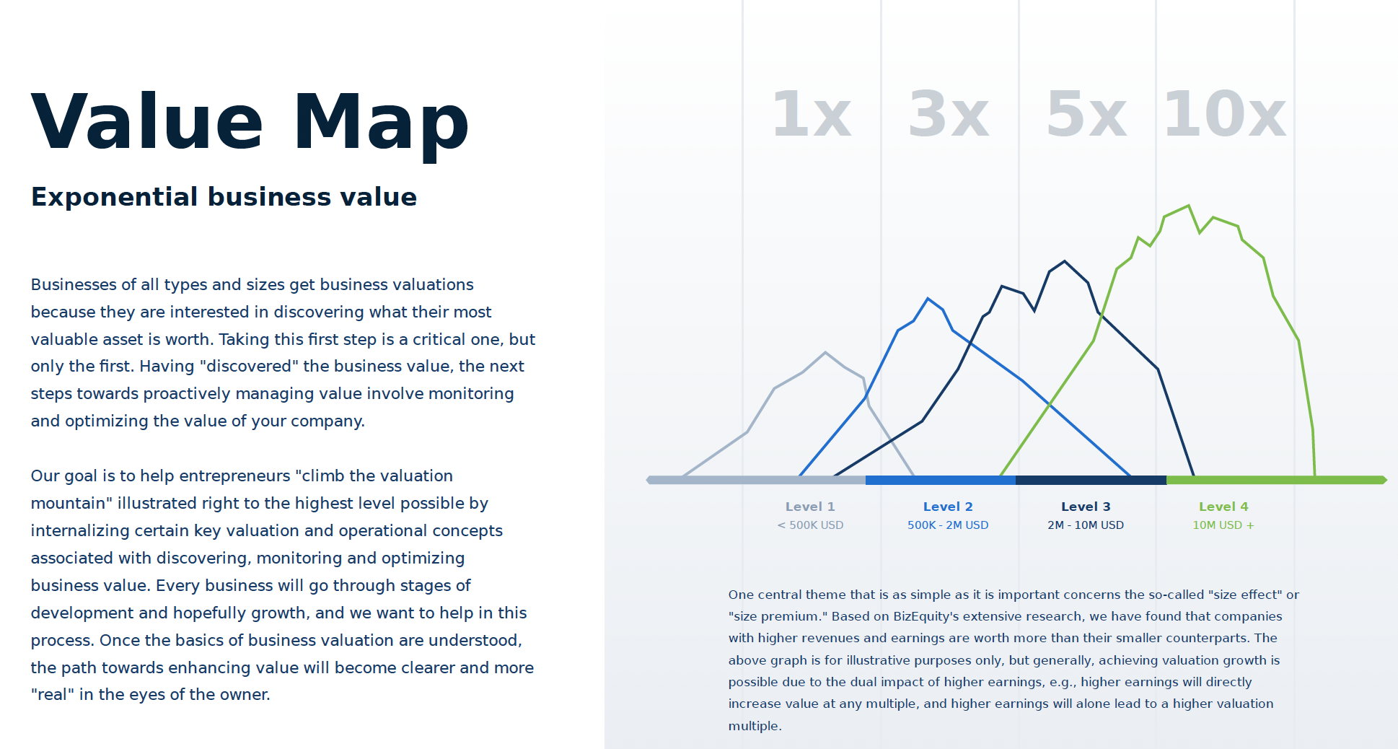

Slide 19
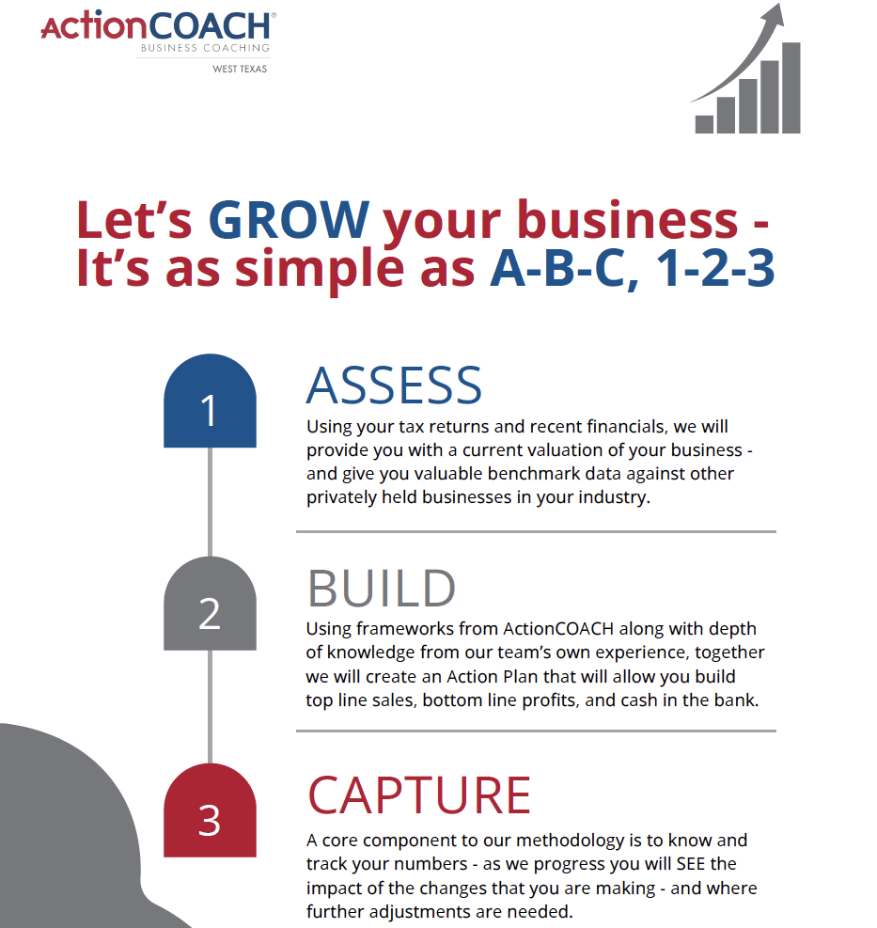
What’s the cost for my client?
Initial valuation + Industry comparable benchmarking - $1800 / entity
Annual updates to valuation
- $900 / entity

Slide 20

Rory Sheppard ActionCOACH of West Texas
We know family business.
Navigating the complexities of a family business can be both rewarding and challenging. As you look towards the future, ensuring a smooth transition, balancing family dynamics, and staying competitive are critical for long-term success. Succession planning is more than just choosing a successor; it involves preparing the next generation to lead with confidence and maintaining the delicate balance of family relationships. This process can be daunting, but with the right guidance, you can secure a legacy that lasts for generations.
ActionCOACH of West Texas
600 S. Tyler, Suite 2100
Amarillo, TX 79101
rorysheppard@actioncoach.com
806 699-1024
WestTexas.ActionCOACH.com

Slide 21
Thanks.
ActionCOACH of West Texas does not represent or endorse the accuracy or reliability of any advice, opinion, statement or any other information displayed or distributed in reporting or its website. The estimates and data contained in valuations are made using the information you provide, publicly available information and data, and rules of thumb for different industries.
BizEquity does not audit or attempt to confirm submitted information for accuracy or completeness in providing valuations.

