Slide 1
Your World in View
May 7, 2025

Slide 2
Today’s Market Landscape
Expectations
Lowering of expected gains / growth as geopolitics and seasonality take hold.
Returns
Market drawdown / liquidations in multiple asset classes raises the forecast for future returns.
Sentiment
It’s easier to be negative and fearful of the future, raising predictions of doom ahead.
adawson@kingsview.com | kingsviewim.com

Slide 3
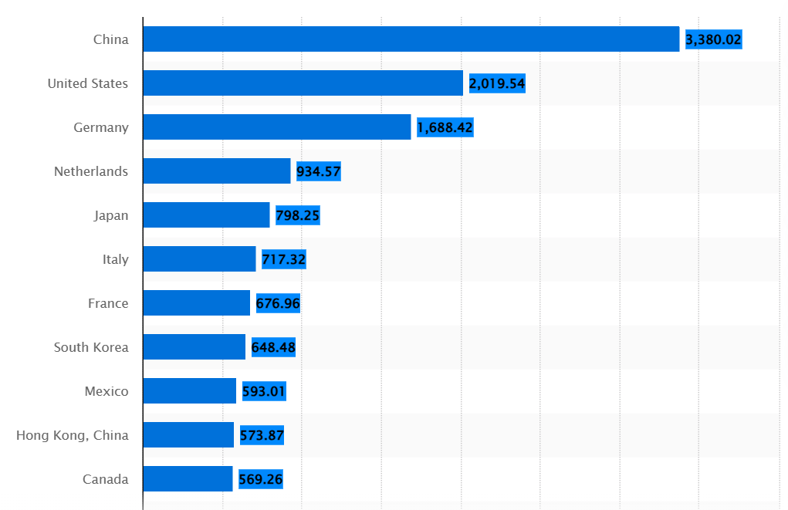
Size matters!
Top Exporting Countries in 2023
Source: Top exporting countries 2023| Statista
adawson@kingsview.com | kingsviewim.com

Slide 4
Rate Cuts?
So far, rates are bumpier (and trending higher) after the “needed” cuts. Thanks, Fed!
Source: YCharts 4-29-25
adawson@kingsview.com | kingsviewim.com

Slide 5
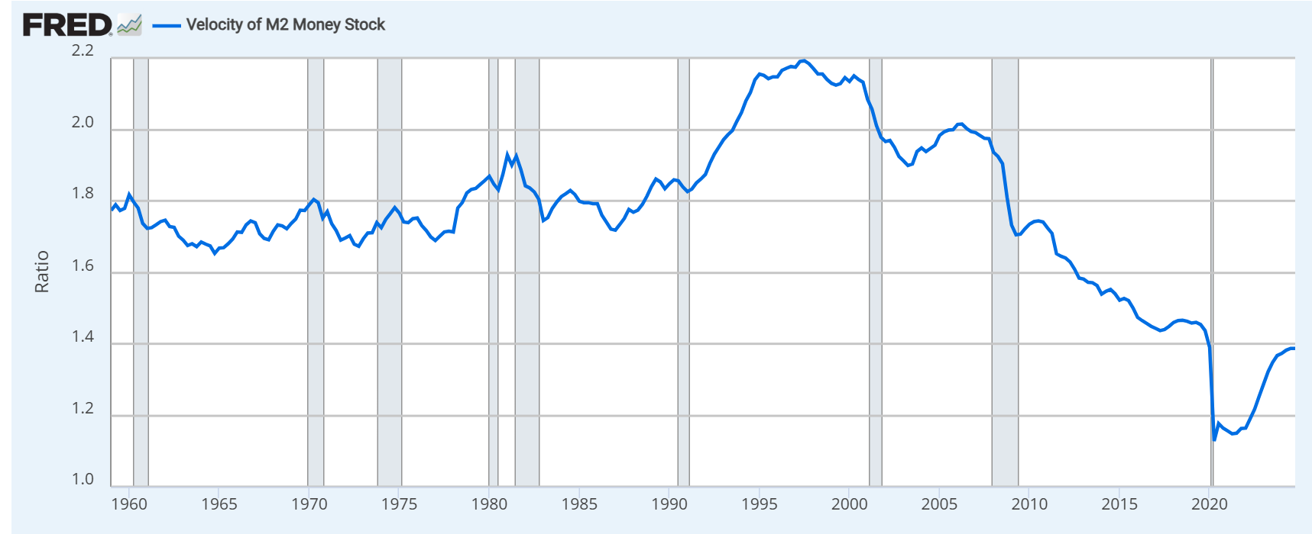
Sustained inflation is always about… money velocity!!
Source: Federal Reserve fred.stlouisfed.org. 1/1/1959 – 1/1/2025
adawson@kingsview.com | kingsviewim.com

Slide 6
Scott D. Martin, CIMA®
Chief Investment Officer
(312) 273-5110 | smartin@kingsview.com
Ashby Dawson, CFP®, AAMS®
Partner | Wealth Manager
(806) 318-6820 | Adawson@kingsview.com
www.kingsviewim.com
www.monarchfunds.com
Kingsview Wealth Management (“KWM”) is an investment adviser registered with the Securities and Exchange Commission (“SEC”). Information presented is for educational purposes only and does not intend to make an offer or solicitation for the sale or purchase of any specific securities, investments, or investment strategies. Investments involve risk and unless otherwise stated, are not guaranteed.

