Slide 1
What the SECURE 2.0 Act Means for
Tax Professionals
Anthony “Tony” P. Curatola Joseph F. Ford Professor
November 9, 2023
This presentation is for the purpose of continuing professional education only and should not serve as the resource for any tax opinion or return position. If tax advice is needed to ensure proper application to your situation, please seek the services of a competent tax professional with your particular facts, circumstances, and situation.

Slide 2
CAA 2023 and SECURE 2.0 Act
CAA 2023 has 35 divisions, of which
The SECURE 2.0 Act is Division T in CAA 2023, and
It is over 360 pages, and
Has over 90 sections
As an aside, Division R is No TIKTOK apps on government devices

Slide 3
Expiring 2022 Business Tax Provisions Status
CAA 2023 and SECURE 2.0 Acts took no action to extend these business provisions. Therefore, the following rules apply for 2022 tax filings:
R&D expenditures must be amortized rather than expensed
Depreciation, amortization, and depletion are not added back to adjusted tax income when calculation the business interest limitation under sec 163(j)
100% bonus depreciation is reduced to 80% beginning in 2023

Slide 4
Issues to be Aware
Gig economy transactions
Potential double counting if client received both a 1099-MISC and a 1099-K for same income
Pursuant to Notice 2023-10, the 1099-K reporting rules are not applicable to 2022 for 3rd party reporting (waiting on Congress to act)

Slide 5
Restaurant Meals
IRC §274 limits the deductibility of a business meal expense to 50% unless an exception applies
TheTaxpayer Certainty and Disaster Tax Relief Act of 2020 modifies §274 by:
Increasing the deduction to 100% for calendar years 2021 and 2022
IRS IR-2021-79 stipulates that the owner or employee must be present at the meal to qualify
IRS Notice 2021-25 provides the following clarifications:
A “restaurant” is a business that sells food or beverages to retail customers for immediate consumption, and take-out meals qualify under this provision

Slide 6
Act § 102 SECURE 2.0 Act Small Business Pension Plan Start-Up Costs
Pre-SECURE 2.0 Act: A business owner can claim a tax credit for the plan’s start-up costs up to:
50% of administrative cost up to $5,000 for
The 1st three years of the plan’s adoption, and
Employers with less than 100 employees
SECURE 2.0 Act: A few modifications are made in this provision, including
Increasing the credit to 100% beginning in 2023 for employers with up to 50 employees, and no change for employers with between 51 and 100 employees
Providing an additional credit for employer contributions of up to
$1,000 per employee for employers with up to 50 employees
Phased out for employers with between 51 and 100 employees (no contribution for employees with wages more than $100,000, indexed for inflation after 2023)
The additional credit is phased out over 5 years
100% in years 1 & 2, 75% in year 3, 50% in year 4, and 25% in year 5

Slide 7
Act § 121 SECURE 2.0 Act Automatic Enrollment Starter 401(k) & 403(b) Deferral-Only Plans
For employers with NO retirement plans, a starter or safe harbor plan is permitted for plan years beginning after December 31, 2023
Elective contributions are permitted by the employee-only
No matching contributions by employer
Minimum annual contribution is 3% and no more than 15% and applied uniformly
Maximum annual contribution amounts cannot exceed $6,000 (COLA apply) and catch-up contributions are applicable for employees 50 or over (COLA apply)

Slide 8
Act § 317 SECURE 2.0 Act Retroactive 1st Year Elective Deferral for Sole Proprietors
Special Rule for Sole Proprietors Adopting a 401(k) Plan
They can make an elective deferral contribution (i.e., an employee contribution) to the plan
If made before the time for filing their individual tax return (without regard to any extensions), and
If the sole proprietor is the only employee, and
If they own the entire unincorporated trade or business
Caution:
This contribution is limited to the plan’s first year, and
Is effective for plan years beginning before the date of enactment (Dec. 29, 2022)

Slide 9
Act § 125 SECURE 2.0 Act Long-Term Part-Time Employees
Long-term part-time employees are allowed to participate in an employer’s 401(k) plan and now in a 403(b) plan, IF they meet the service and age requirements
The service requirement is satisfied if the employee worked 2 consecutive years (not 3 as provided in SECURE Act of 2019) of 500 hours or more, and
The employee is at least age 21 by the end of the 2-year period
This rule change is effective for plans years beginning after December 31, 2024
In addition, Pre-2021 Service are not considered for vesting purposes

Slide 10
Act §§ 115 and 127 SECURE 2.0 Act IRC § 72 and Certain Emergency Expenses
IRC § 72 Imposes a 10% Penalty on Early Withdrawals
There are several exceptions to this penalty (some good and some not so good)
Death, Disability, First-time home buyer, Higher education costs to name a few
Act § 115 SECURE 2.0 (makes this more like a savings acct and not a retirement acct) adds unforeseen or immediate financial needs (after 2023)
Limited to one distribution of $1,000 per year
Repayable within three years
Additional distributions can be taken during repayment period only if first distribution is repaid

Slide 11
Act §§ 115 and 127 SECURE 2.0 Act IRC § 72 and Certain Emergency Expenses
Act § 127 SECURE 2.0 further adds an employer sponsored emergency savings provision for non-highly compensated after 2024
Limited to one withdrawal of $1,000 for personal & family emergencies needs
Employer can automatically opt employees into these savings accounts
Limit contributions to no more than 3% of salary and
Capped at $2,500 (or lower by employer) for employee contribution
If contribution exceeds the cap, then additional amounts are credited to employee’s designated Roth (if one) or stopped until balance permits additional contributions
No fees on 1st four withdrawals
At separation from service, employee can rollover funds to their Roth or IRA

Slide 12
Qualified Plans and IRAs Contributions
Non-SIMPLE and 457 Plans:
Elective contributions limited to $20,500 in 2022, $22,500 in 2023, and $23,000 in 2024
Catch-up contribution is $6,500 in 2022 and $7,500 in 2023 & 2024
SIMPLE Plans:
Elective contributions limited to $14,000 in 2022, $15,500 in 2023, and $16,000 in 2024
Catch-up contribution is $3,000 in 2022 and $3,500 in 2023 & 2024
Source: Notice 2021-61 and 2022-55

Slide 13
Act § 109 SECURE 2.0 Act Catch-Up Limits
Higher Catch-Up Limits Beginning in 2025
For participants ages 60, 61, 62, and 63
Indexed for inflation beginning in 2026
Non-SIMPLE and 457 Plans:
Catch up contribution is $11,250, which is 50% more than the regular catch-up amount in 2024
SIMPLE Plans:
Catch up contribution is $5,000 or 50% more than the regular catch-up amount in 2025 (hopefully this is a typo). If so, then the catch-up contribution is $5,250 ($3,500 x 1.5)

Slide 14
Act § 603 SECURE 2.0 Act Elective Deferrals Restricted to Designated Roth Contributions
Beginning in tax year 2024, there are new higher catch-up limits
For Non-SIMPLE and 457 Plans:
All catch up contributions are mandatory Roth contribution IF
Individual had wages in the preceding year more than $145,000 indexed for inflation
Implementation of this provision falls on employer, not individual
Other individuals are not subject to the mandatory Roth contribution provision
For SIMPLE IRA and SEP Plans:
No mandatory Roth IRA contribution restriction applies

Slide 15
Act § 604 SECURE 2.0 Act Matching and Nonelective Contributions
Employer Matching and Nonelective Contributions
Pre-SECURE 2.0 Act: Employers are not permitted to make matching or nonelective contributions of as designated Roth contributions
SECURE 2.0 Act: Plans may permit a participant in non-SIMPLE and 457 plans to designate some or all matching & nonelective contributions of the employer as designated Roth contributions
This provision is effective beginning with contributions made after the date of enactment, which is December 29, 2022
This provision only applies to the extent a participant is fully vested in these contributions

Slide 16
Act § 117 SECURE 2.0 Act SIMPLE Plan Contributions
New higher contribution limits are introduced for participants in a SIMPLE plan
These new contribution amounts are effective for 2024 and are dependent on the number of employees. That is, the contribution amount is increased:
By 10 percent, as compared to the limit that would otherwise apply in the first year this change is effective (
For an employer with no more than 25 employees, and
For an employer with 26 to 100 employees if the employer provides
A 4 percent matching contribution, or
A 3 percent employer contribution
Note: Act § 117 makes similar changes to the contribution limits for SIMPLE 401(k) plans

Slide 17
Act § 116 SECURE 2.0 Act SIMPLE Plan Contributions
An employer is permitted to make additional contributions to each employee participating in the SIMPLE plan if the plan provides that the contributions
Are made in a uniform manner, and
May not exceed the lesser of up to 10 percent of compensation or $5,000 (indexed).
This new provision becomes effective for taxable years beginning after December 31, 2023

Slide 18
Act § 110 SECURE 2.0 Act Matching and Student Loan Payments
Beginning in 2024, an employer may make a matching contribution on behalf of an employee to
The company’s 401(k), 403(b), or SIMPLE plan
Based on the employee’s repayment amount of their higher education student loan
Effective for contributions made after plan years beginning after Dec. 31, 2023
Government employers are also permitted to make matching contributions to their 457(b) plans

Slide 19
Act § 320 SECURE 2.0 Act
Defined contribution plans are now exempt from intermittent notification requirements to unenrolled participants (i.e., disclosures, notices, and plan documents) who:
Have elected not to participate, and
Have already received a summary plan description
Plans are not required to provide any other notices related to initial eligibility to participate in the plan
Plans, however, must still provided unenrolled participant
An annual reminder notice of their eligibility to participate, as well as any applicable plan deadlines; and
Any document they request that they would be entitled to receive under existing law absent this Act provision.
This provision applies to plan years beginning after December 31, 2022

Slide 20
Act § 327 SECURE 2.0 Act
Surviving Spouse Election to be Treated as Employee
If they are the sole beneficiary on the employer sponsored retirement plan, and
Deceased spouse dies before RMDs have begun
If the surviving spouse dies before the distributions begin, the surviving spouse is treated as the employee for applying the RMD rules
Note: The IRS is charged with providing guidance in this area
This provision is effective for calendar years beginning after December 31, 2023
Note: This election is applicable only if the surviving spouse is the sole beneficiary (not sole designated beneficiary unless Treasury provides a different view)

Slide 21
Expiring 2022 Individual Tax Provisions Status
Without new legislation, the following individual tax rules changes apply for 2022 tax filings:
Child tax credit is $2,000 ($3,600 in 2021) & up to $1,400 is refundable
Child and dependent care credit returns to $2,100 ($8,000 in 2021)
Increased exclusion for employer-provided dependent care assistance
Earned income credit is $500 ($1,500 in 2021) for individuals without a qualifying child
Mortgage insurance premiums is not deductible as mortgage interest after 2021
No $300 (or $600) above-the-line charitable contributions for non-itemizers
Percentage limits for charitable contributions of cash returns to 60% of AGI (100% in 2021)
Note: Extender provisions were not included in CAA 2023 or SECURE 2.0 Acts

Slide 22
Act § 108 SECURE 2.0 Act Qualified Plans and IRAs Contributions
Traditional IRAs:
$6,000 ($7,000 age 50 & older) in 2019 through 2022, $6,500 for 2023 and $7,000 for 2024
No age restriction beginning with 2020
Deduction is phased out based on MAGI if participant (or spouse) is in employer’s plan
Roth IRAs:
$6,000 ($7,000 age 50 & older) in 2019 through 2022 and $6,500 ($7,500) for 2023
Deduction is phased out based on MAGI
Catch up contribution for IRAs is $1,000 in 2022 and 2023 (not indexed under pre-SECURE 2.0 Act)
Catch up contribution for IRAs is $1,000 for 2024 (this amount is indexed for inflation under SECURE 2.0 Act) beginning in 2024.

Slide 23
Act § 103 SECURE 2.0 Act Saver’s Match
Pre-SECURE 2.0 Act: A nonrefundable 50% credit of up to $2,000 is available to individuals who
Contribute to their IRA or retirement plan
SECURE 2.0 Act: Replaces the credit with a federal match contribution to the individuals IRA or retirement plan
Matched amount phases out between
$41,000 and $71,000 for taxpayers filing jointly
$30,750 and $53,250 for taxpayers filing head of household
$20,500 and $35,500 for all other taxpayers

Slide 24
Act § 107 SECURE 2.0 Act Age Requirement for RMD
Increase in Age for RMD
Beginning in 2023, the applicable RMD increases to age 73 (was 72)
Beginning in 2033, the applicable RMD increases to age 75
Net effect of change is:
Anyone who attains age 73 in 2023 must take their 1st RMD in 2023 (i.e., by April 1, 2024), and thereafter
Anyone who attains age 75 in 2033 must take their 1st RMD in 2033 (i.e., by April 1, 2034), and thereafter

Slide 25
Act § 325 SECURE 2.0 Act Roth IRA RMD
Pre-SECURE 2.0 Act: Under current law,
Roth IRAs are not subject to the RMD rules prior to death,
Designated Roth IRAs in employer sponsored plans are subject to the RMD rules upon separation from service
SECURE 2.0 Act: Beginning in 2024,
Designated Roth IRAs in employer sponsored plans are no longer subject to the RMD rules upon separation from service

Slide 26
Pre-Act § 202 SECURE 2.0 Act Qualified Longevity Annuity Contracts
Pre-SECURE 2.0 Act: A plan owner can fund the QLAC from their qualified plan up to the lesser of:
A maximum limit, or 25% of the qualified plan balance
What is the maximum funding limit?
$155,000 in 2023 (Notice 2022-55), and
$145,000 in 2022 (Notice 2021-61)
The QLAC amount is deducted from the account balance when computing the RMD amount, thus
A person can spread out their retirement funds over a longer period,
By reducing the RMD amount, a person incurs a lower tax liability during the early years of retirement, which also may translate into a lower Medicare premium, but
The annuity portion of the QLAC must begin no later than age 85

Slide 27
Act § 202 SECURE 2.0 Act Qualified Longevity Annuity Contracts
SECURE 2.0 Act: Several changes are made to QLACs, including
A plan owner can fund the QLAC from their qualified plan
Up to $200,000 (increased from $155,000), indexed for inflation as of the date of enactment (Dec. 29, 2022)
Therefore, we have a new retroactive maximum limit, and the 25% limit is repealed
QLAC can now include a spousal survival rights provision
A free-look back period of up to 90 days is permitted with respect to contracts purchased or received in an exchange on or after July 2, 2014

Slide 28
Act § 333 SECURE 2.0 Act Early Distribution & Excess Contribution Excise Taxes
Additional 10% tax on Early Distributions & 6% Excess Contribution tax
Pre-SECURE 2.0 Act: There are several remedies when an individual makes an excess contribution
One of which is to withdraw the excess contribution & its earnings before the tax return is due (including extensions)
Avoid 6% excess contribution tax but the additional 10% tax is applied to the withdrawn interest
SECURE 2.0 Act: The 10% additional tax no longer applies on the returned interest resulting from correcting an excess contribution to one’s IRA.
This provision is effective on the date of enactment (December 29, 2022), without regard to whether the act (or failure to act) upon which the determination is based occurred before such date

Slide 29
Act §§ 314 and 326 SECURE 2.0 Act Early Distribution Excise Taxes
SECURE 2.0 Act: The 10% additional tax no longer applies on several new situations
Act § 314 allows domestic abuse survivors to withdraw retirement savings after 2023
Up to the lesser of $10,000 or 50% of the participant’s account without incurring the 10% tax, and
To repay the withdrawn money over 3 years AND to recover the taxes paid on the withdrawn money
Act § 326 allows terminally ill individuals to withdraw retirement savings after the enactment date (Dec 29,2022)
Act § 308 allows private sector firefighters to withdraw retirement savings at age 50 (same as public sector firefighters)

Slide 30
Act § 311 SECURE 2.0 Act Qualified Birth or Adoption Distribution Provision
Pre-SECURE 2.0 Act: The 10% additional tax does not apply on distributions up to $5,000 for qualified birth or adoption distributions from qualified retirement plans
More importantly, the opportunity exists to recontribute the withdrawn amount at any time as a rollover.
However, the Code does not permit a taxpayer to file an amended tax return after 3 years and thereby claim a refund of taxes paid in the year of distribution
SECURE 2.0 Act: Modifies the repayment period as follows:
To the 3-year period beginning on the day after the distribution was received, and
This provision is effective for distributions made after the date of enactment (Dec. 29, 2022)

Slide 31
Act § 302 SECURE 2.0 Act Minimum RMD Excise Tax
Pre-SECURE 2.0 Act: Failure to take an RMD in the appropriate year carries a 50% excise tax penalty
SECURE 2.0 Act: Several relief provisions are provided in this Act effectively after the date of enactment
The 50% tax is reduced to 25% excise tax
The 25% tax is further reduced to 10% if the RMD failure is corrected within the correction window
The correction window means the period beginning on the date the tax is imposed and ending on the earliest of:
The date of the notice of deficiency is mailed,
The date on which the excise tax is assessed, or
The last day of the second taxable year that begins after the end of the taxable year in which the excise tax is imposed.

Slide 32
Minimum RMD Excise Tax Remedy
Remedies: There is a remedy for failing to take an RMD in the appropriate year from an IRA
Waiver of tax for reasonable cause. The IRS can waive part or all the tax if the taxpayer can show that any shortfall in the amount of distributions was due to reasonable error and they are taking reasonable steps to remedy the shortfall
In such cases, the taxpayer attaches a statement of explanation to the return, including Form 5329
The IRS reviews the information provide by the taxpayer and decides whether to grant the request for a waiver.
If the request is not granted, the IRS will notify the taxpayer regarding any additional tax owed on the shortfall

Slide 33
Notice 2022-53 and Notice 2023-54
RMD for Inherited Plans
Final regulations are coming for handling the RMDs for inheritors, but Treasury decided that
It will not apply prior to 2023 per Notice 2022-53, and now
It will not apply prior to 2024 per Notice 2023-54
Eligible designated beneficiaries can elect to take the distribution
Over their life or
Elect the 10-year rule
When EDB dies, the beneficiary must elect the 10-year rule
Under proposed regulations, the RMD rules apply during the 10-years.
Note: If 50% penalty was paid for failing to take RMD by beneficiary in 2021, a refund may be requested

Slide 34
Estate Tax Issue Unused Deceased Spousal Exclusion
Unused amount can be passed to surviving spouse
If deceased’s estate uses $8M of unified tax credit in 2023, then the remaining $5.61M can be passed to the surviving spouse
The
Portability election is made by filing Form 706
Form 706 is not filed if estate is below the UTC amount UNLESS, estate is making portability election
See Part 6 of Form 706 and Part 6A is checked to opt out of portability
Rev. Proc. 2022-32 extends the portability election for these non-req filers to the 5th anniversary of decedent’s death. (frees up IRS resources - no need to file PLR)

Slide 35
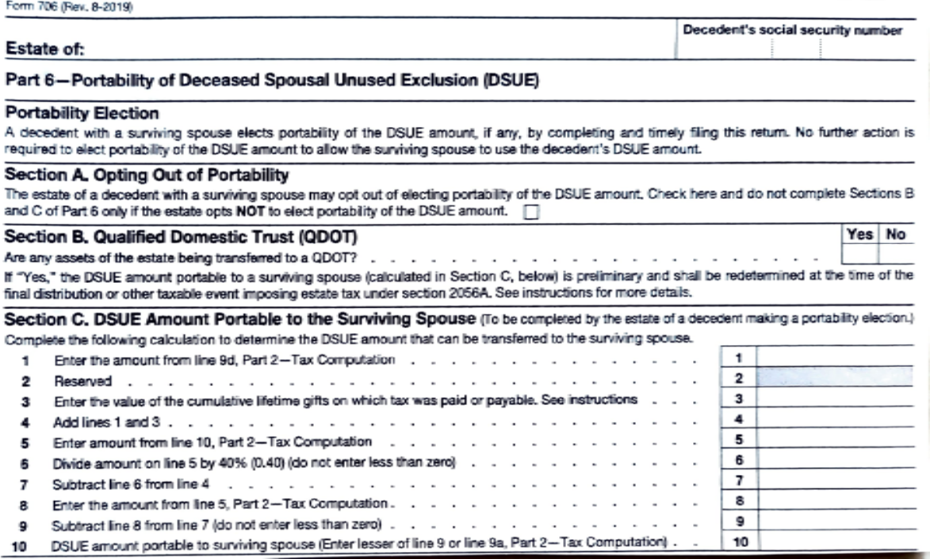
Form 706 – Part A – Portability Election for Deceased Spouse

Slide 36
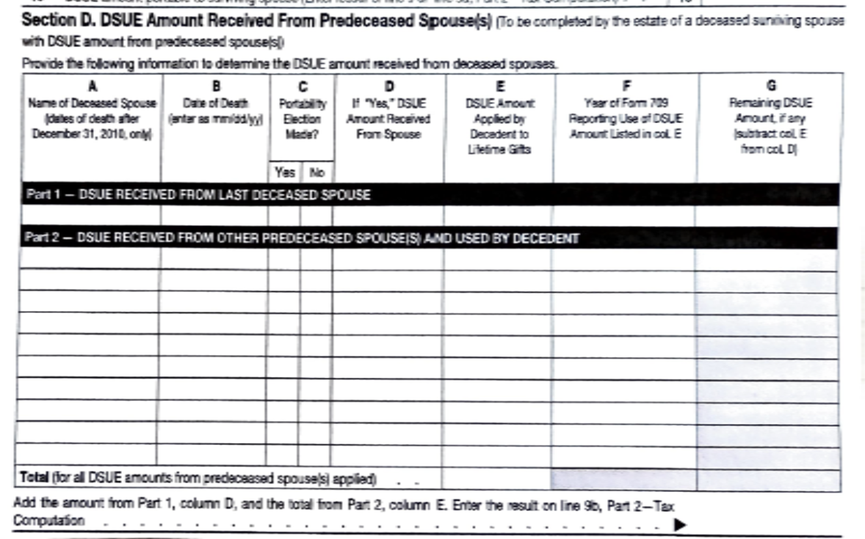
Form 706 – Part 6D – Deceased Spouse Unused Exclusion Amt Received by Surviving Spouse

Slide 37
Impact of Unified Tax Credit after 2025
Exclusion amount is scheduled to drop to pre-2018 levels (unless legislation is passed to extend, which is $5M adjusted for inflation (or reduce it as discussed on prior screen) – we will wait to see that number)
Key Point: Individuals taking advantage of the increased gift tax exclusion amount in effect from 2018 to 2025 will not be adversely impacted after 2025 IF the exclusion amount drops to pre-2018 levels (see, Reg. §20.2010-1(c)(2), Illustration 1)
The regulations provide a special rule that effectively allows the estate to compute its estate tax credit using the greater of the basic exclusion amount (BEA) applicable to gifts made during life, or the BEA applicable on the date of death.
Failing to take advantage of it will not provide additional UTC exemption amount
So, use it or lose it
For more specifics on this issue, see https://www.irs.gov/newsroom/estate-and-gift-tax-faqs or Reg. §20.2010-1

Slide 38
Unified Tax Credit Example
Illustration 1: A, who has never married, made taxable gifts of $9 million, all of which were sheltered from gift tax by the $11.4 million in basic exclusion amount that was allowable on the dates of the gifts.
A dies after 2025, when the basic exclusion amount is $6.8 million. A was not eligible for any restored exclusion amount pursuant to Notice 2017-15.
Because the total of the amounts allowable as a credit in computing the gift tax payable on A's gifts (based on the $9 million basic exclusion amount used to determine those credits) is greater than the credit based on the $6.8 million basic exclusion amount applicable on the decedent's date of death, the credit to be applied for purposes of computing the estate tax is based on a basic exclusion amount of $9 million, the amount used to determine the credits allowable in computing the gift tax payable on the post-1976 gifts made by A.
Failing to make the gifts during the 2018-25 period, doesn’t allow you to take the unused amount forward. In this case, the unused $2.4M is lost (use it or lose it).

Slide 39
Sources
Consolidated Appropriations Act of 2023 (CAA 2023)
SECURE 2.0 Act of 2022 (Division T of CAA 2023)
No TIKTOK on Government Devices (Division R of CAA 2023)
Notice 2017-15, Unused Unified Tax Credit
Notice 2023-23, July 2023, RMDs in 2023
Notices 2022-53 and 2023-54, July 2023, RMDs and Inherited IRAs
Notice 2023-75, Nov 2023, COLA adjustments for 2024

Slide 40
That’s Completes Our Presentation On the SECURE 2.0 Act Can I Answer Any Questions
Thank You

